Slide 1




31.05.24
Sophie Caroni, Aria Darmanger, and Olivia Lecomte
Multimodal User Interfaces
Notes:
SOPHIE
Presenting Vubot visual assistant

Slide 2
Table of Contents
Introduction
Software Architecture
Evaluation
Limitations and Future Work
Conclusion
Notes:
SOPHIE

Slide 3

Introduction
31.05.24
Notes:
SOPHIE

Slide 4

Concept & Aim
Clinical application
Associative visual agnosia
Intact vision
Object recognition deficits
Can involve colors
→ Develop visual assistant
Notes:
SOPHIE
Idea: build a system somehow related to neuroscience and/or with a clinical application
So we defined our target in neurological* patients experiencing agnosia
Agnosia in general = «inhability to recognize or identify things e.g. objects (despite having functioning sensoriality)»
Many different types, we focused on associative visual agnosia: patients visually perceive objects but cannot identify them
Visual agnosia could also involve inability to distinguish and identify colors
So what we did was develop a bot that could act as assistant for object recognition
*usually agnosia follows cerebral damage
More on agnosia:
Associative visual agnosia = difficulty with understanding the meaning of what they are seeing. They can draw or copy but do not know what they have drawn. They correctly perceive the form and know the object when tested with verbal or tactile information, but cannot identify the object. They are unable to link the fully perceived visual stimulus to prior experience to help them recognize the stimulus.

Slide 5

Modalities overview
Notes:
SOPHIE
Our system:
Input modalities:
Gesture
Speech
-
=> Commands combination trigger object and color detection, that will be returned as textual output
(The application involves using the webcam to recognize a set of gesture and vocal commands to obtain object and color detection.)

Slide 6
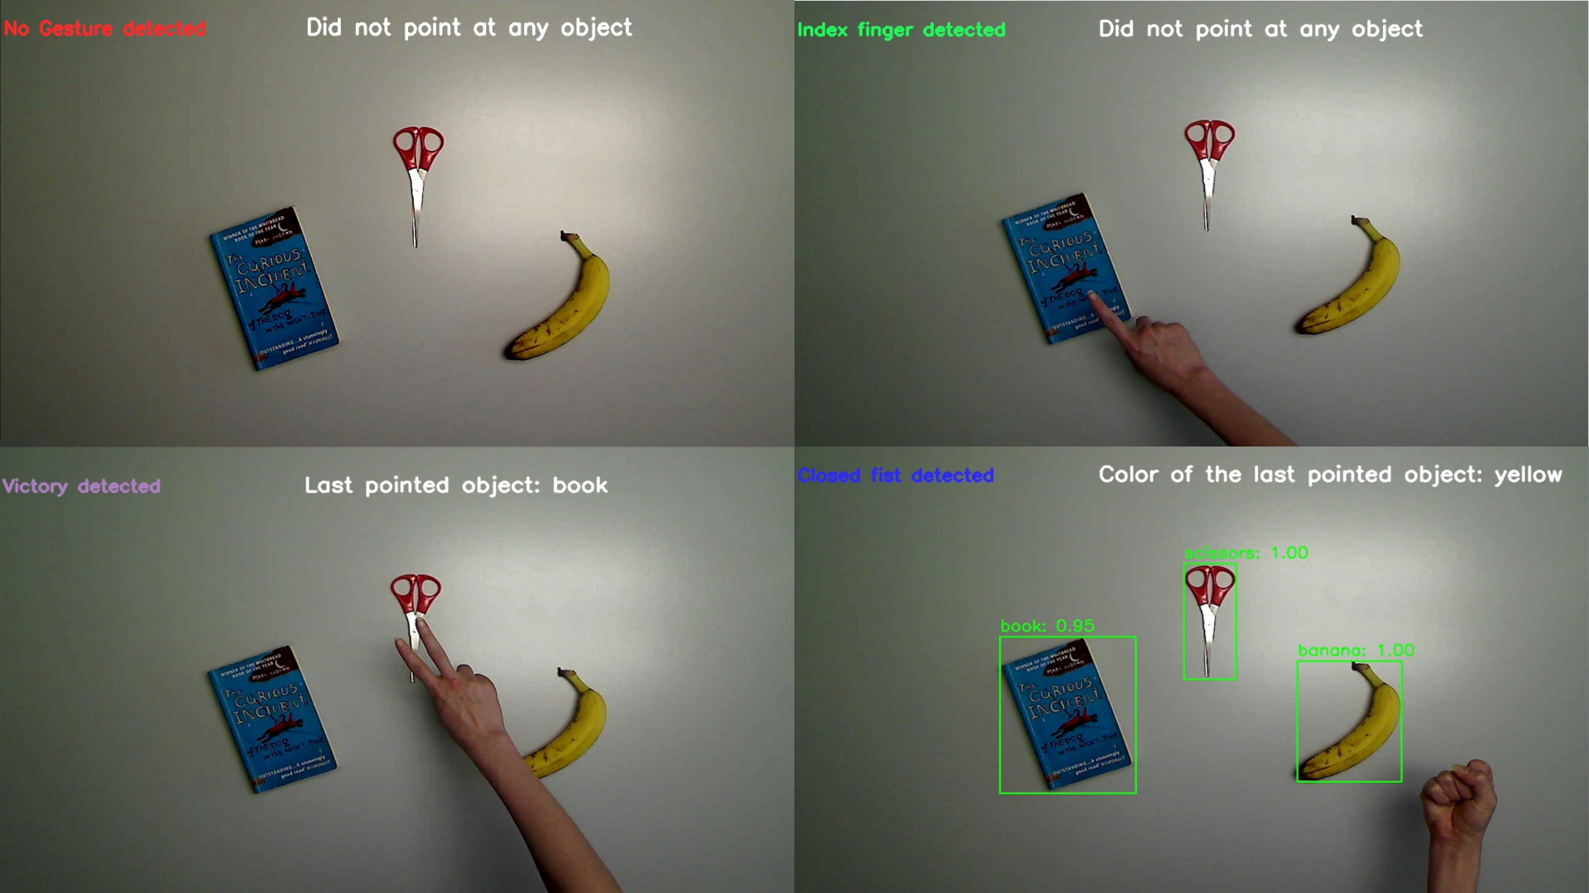
Recognized Gestures
Notes:
SOPHIE
Defined a set of specific target gestures and vocal commands, each responsible for a specific function
In detail, the featured option available are:
single object detection, triggered by the vocal command “object” and two different gestural commands possible: pointing index or the victory sign - mechanism: index fingertip’s coordinates captured their location in the video frame; in that point the pixels are analyzed and any object present at that point among those detected will be identified
similarly, single object color detection, triggered by the vocal command “color”, and again the possibility of pointing index or victory sign
multiple object detection of all the objects on the scene at the same time, triggered by the command “all items” closed fist
in this case permanent square boxes around each item also appear to distinguish them, and the accuracy confidence of the model rate is displayed
Feedbacks on the screen are displayed to make the patient aware of the gesture detected, as well as the output of its query
This will all become more clear by viewing the demo video

Slide 8
Software Architecture
31.05.24

Slide 9


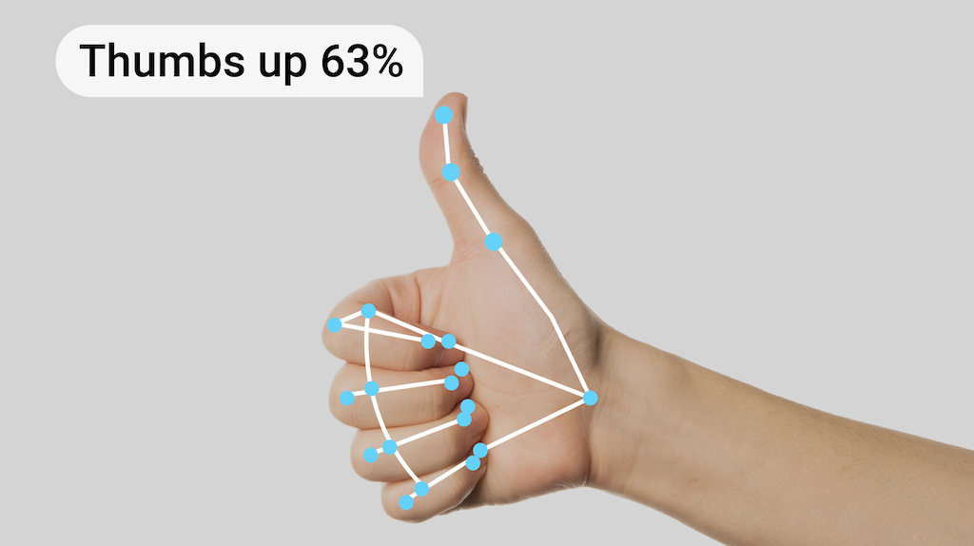
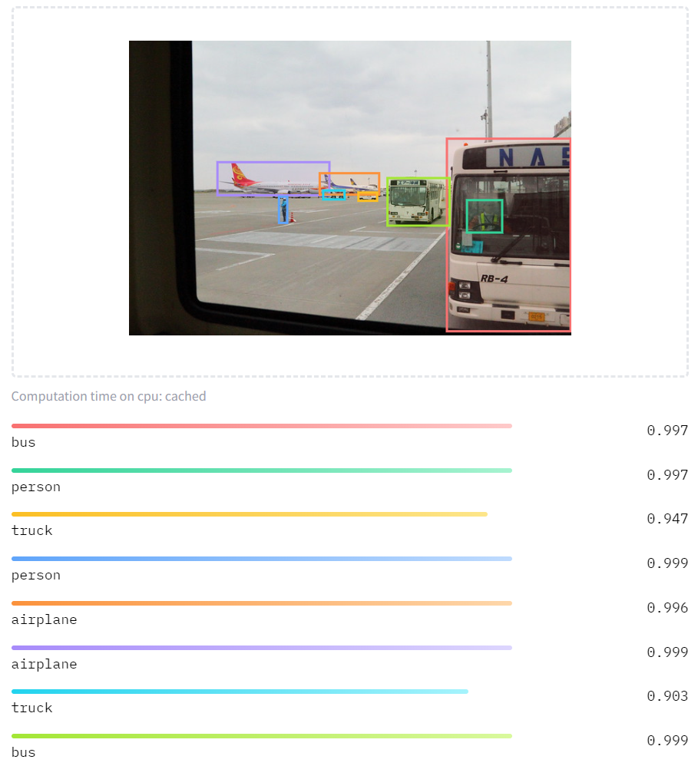

Libraries
openai/whisper-large-v3
facebook/detr-resnet-50
Notes:
Let’s talk about how VuBot is built and the technology behind it.
We use OpenCV, for capturing live video, processing images and giving visual feedbacks to the user.
For recognizing gestures, we use the gesture model from from MediaPipe.
For detecting objects, we use a model called DETR made by Meta . As you can see in this illustration, it helps identify objects from a predefined list.
Finally, for understanding speech commands, VuBot uses the OpenAI Whisper model.

Slide 10
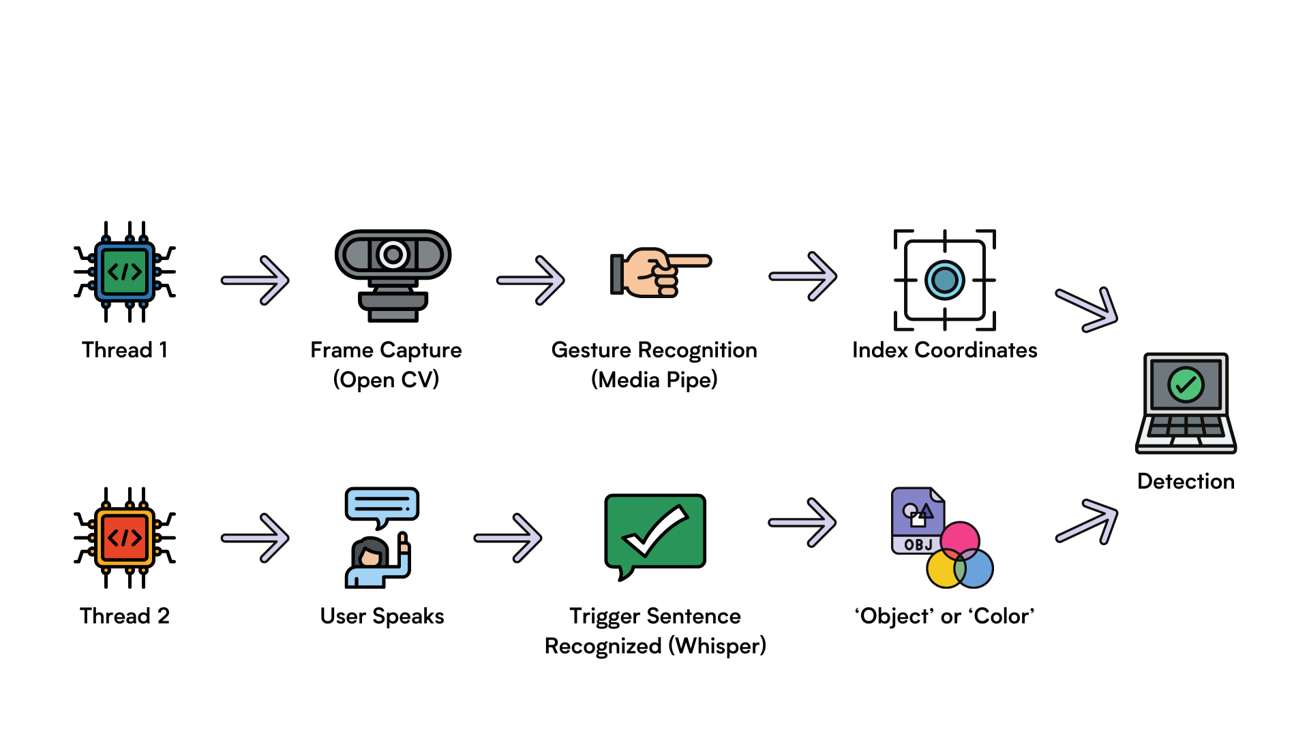
Modality Fusion
Notes:
VuBot works using two main threads, each handling a different aspect of the system, and they work in parallel.
First thread deals with video capture and gesture recognition.

Slide 11
Modality Fusion
Notes:
It starts by capturing frames using OpenCV.

Slide 12
Modality Fusion
Notes:
Each captured frame is then processed by MediaPipe to recognize potential gestures.

Slide 13
Modality Fusion
Notes:
Second thread focuses on speech recognition.

Slide 14
Modality Fusion
Notes:
It listens for user speech.

Slide 15
Modality Fusion
Notes:
Once a trigger sentence like "object" or "color" is recognized using the Whisper model, it gets ready to process the command.

Slide 16
Modality Fusion
Notes:
Once a trigger sentence like "object" or "color" is recognized using the Whisper model, it gets ready to process the command.

Slide 17
Modality Fusion
Notes:
VuBot combines these informations, and starts the object detection process to see if the pointing gesture is aimed at a recognized object. If needed, it will also capture the color of this object.

Slide 18
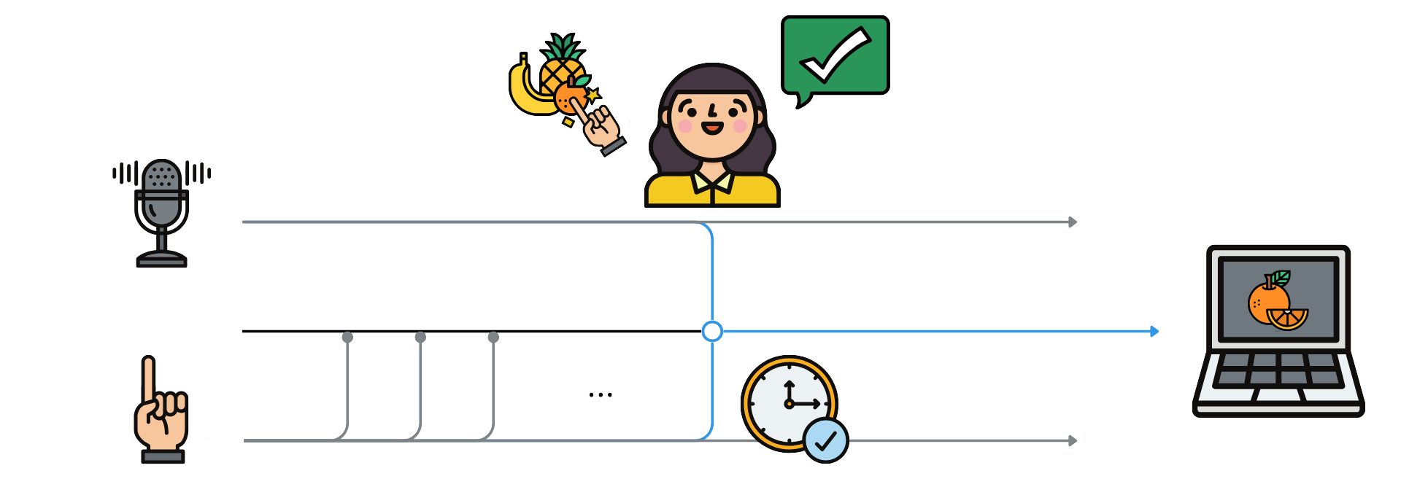
CARE/CASE Models
CARE: Complimentary
CASE: Synergistic
Notes:
So Both speech and hand recognition are needed to start the object detection process.
If either one is missing, VuBot keeps capturing frames and listening for audio; both in parallel to stay responsive.
Ensuring the app staysd efficient in handling each modality.
This need for both gesture and speech inputs; at the same time aligns with the complimentary care and synergistic case models
CARE = Complementarity :
If multiple modalities are to be used within a temporal window to reach a given state
No modality taken individually is sufficient to reach the state
Can occur sequentially or in parallel
CASE = Synergistic :
A task, in parallel, using several modalities

Slide 19
Evaluation
31.05.24

Slide 20
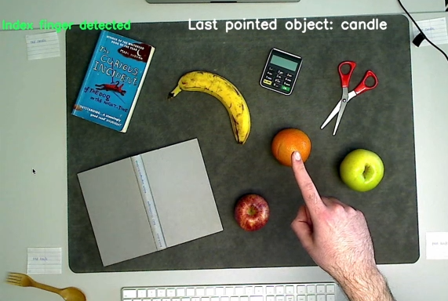
Experiment
Task: find target objects and colors
Vary input modality
Speech input (original version)
Keyboard input (alternate version)
Healthy participants
Manipulate labels to simulate recognition deficits
Notes:
Randomised trials

Slide 21
Statistical Analysis
Time
Query time (object vs. color)
Task time (keys vs. speech)
Accuracy
Task versions (keys vs. speech)
Models

Slide 22
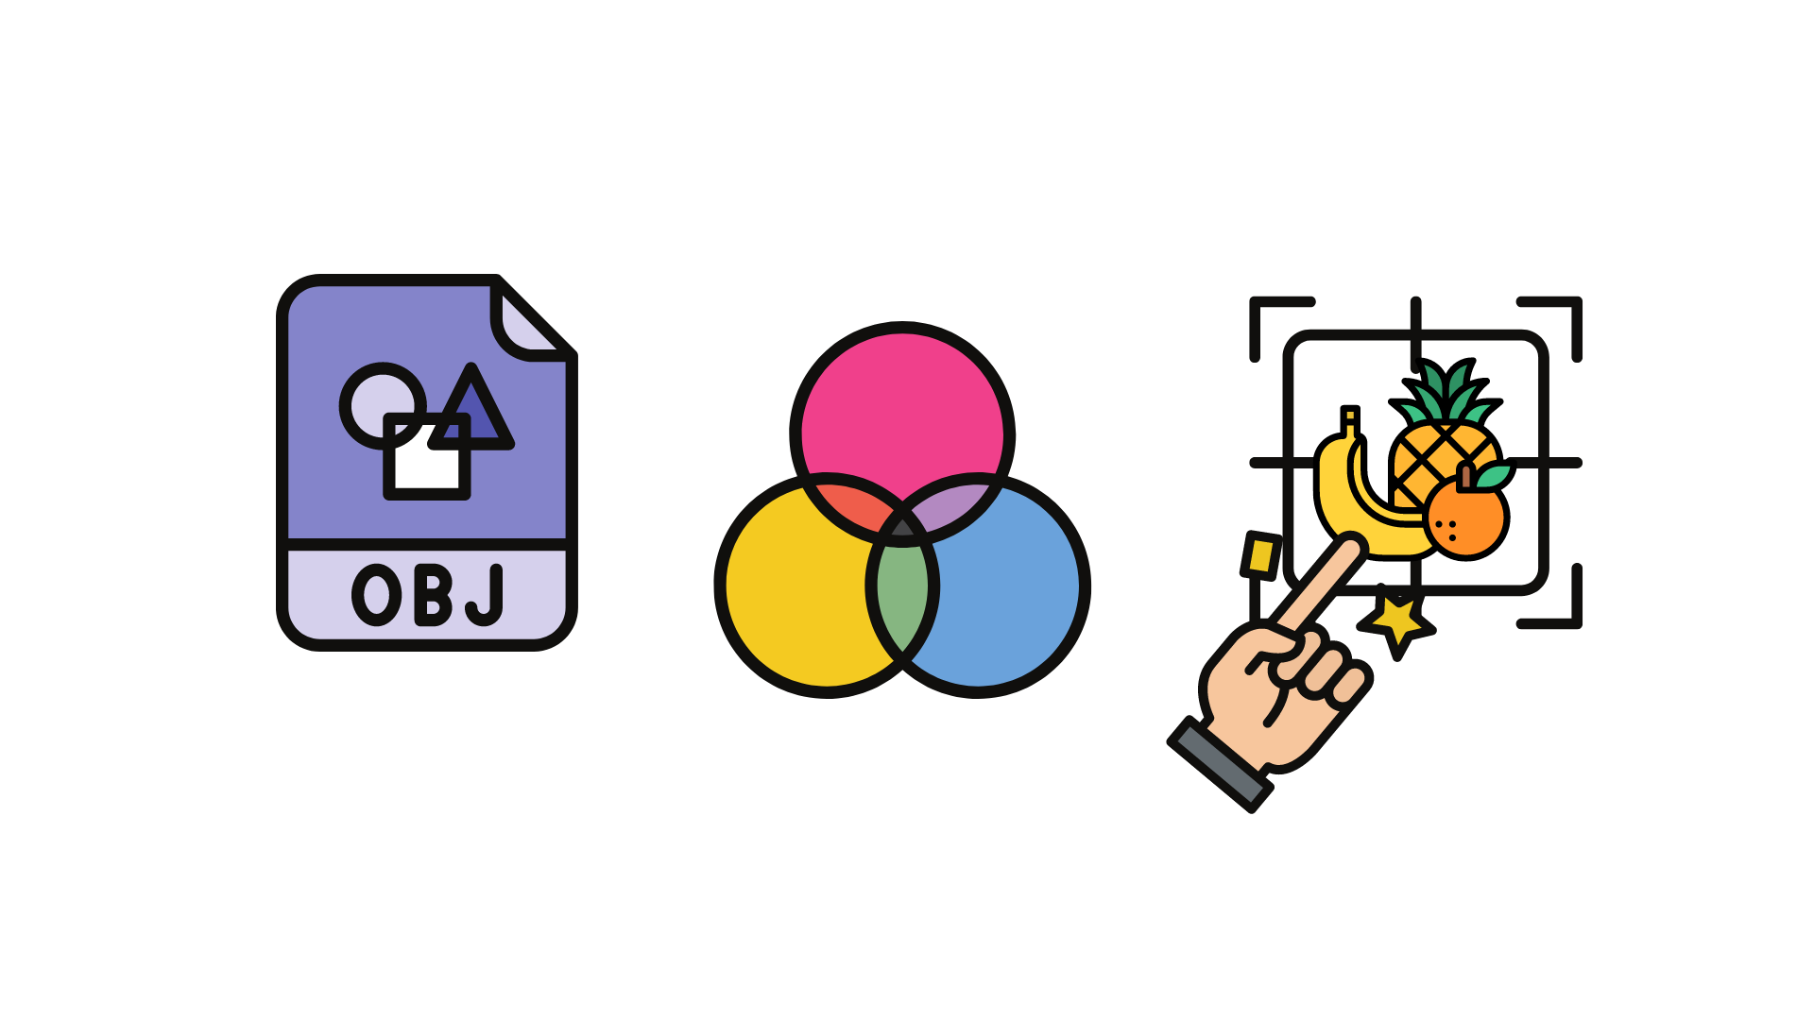
Query Runtimes
Object and color queries take the same amount of time to compute
=
Notes:
0.66-0.68s

Slide 23
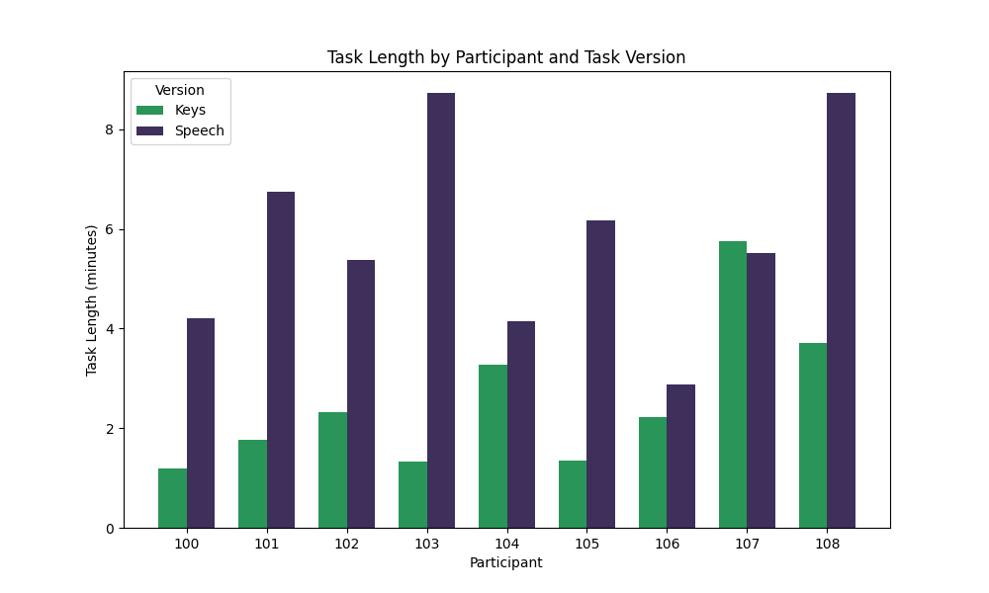
Runtime Performance
Task is shorter when querying with keys than with speech
M_keys = 2.55min
M_speech = 5.83min

Slide 24
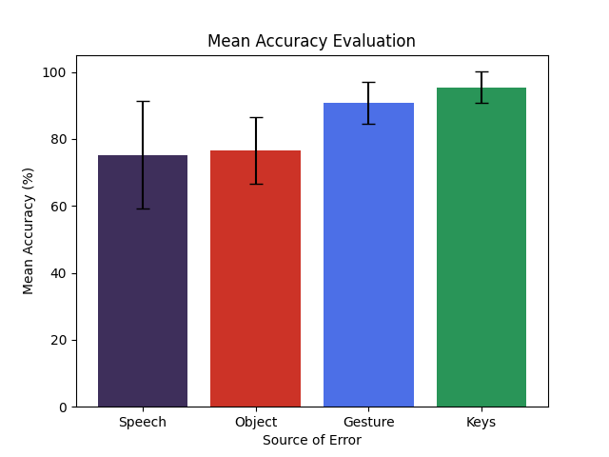
Accuracy
Tracking of errors via screen recordings
More speech errors than key errors
Generally high accuracy across recognition models (80%)
Notes:
OLIVIA
We identified a set of possible error responses of the bot during the evaluation trials, such as e.g.
speech errors for wrong transcription
not responding to participants pressing keys
not detecting of target gestures,
…
We computed the accuracy by computing the proportion between errors and total queries
Result:
All three recognition models performed with high accuracy
In the speech version of the tasks, the system did make more mistakes

Slide 25
Interpretation of Results
Keys outperformed speech
Speech remains the best modality for the future development of VuBot
Natural
Hands-free
Simpler scalability

Slide 26
Limitations and Future Work
31.05.24

Slide 27
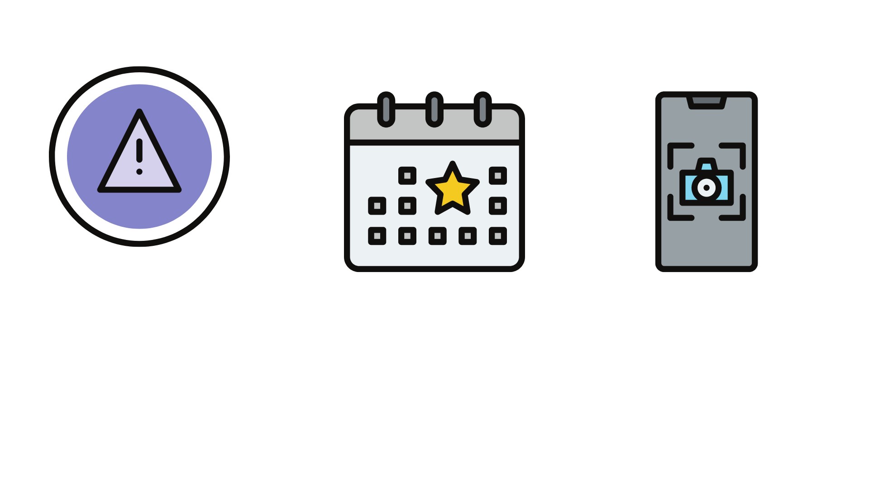
Limitations
General Recognition Errors:
Mistakes due to lighting or camera angles
Color Recognition
Background and hand influence
Speech Recognition:
Not meant for live transcription
Prononciation of trigger words

Slide 28
Future Works
Mobile Version
Large Language Model (LLM) Integration

Slide 29
Conclusion
31.05.24

Slide 30

Conclusion
VuBot is a visual assistant
Complementary and synergistic fusion
Recognizes objects and colors
Many limitations
This combination of modalities is best for future development
Potential to empower individuals to have more independence

Slide 31
Thanks for listening
31.05.24

Slide 32
References
Icons : Canva – iconixar
Lee, J., Wang, J., Brown, E., Chu, L., Rodriguez, S. S., & Froehlich, J. E. (2024). GazePointAR: A Context-Aware Multimodal Voice Assistant for Pronoun Disambiguation in Wearable Augmented Reality (arXiv:2404.08213). arXiv. https://doi.org/10.48550/arXiv.2404.08213
Openai/whisper-large-v3 · Discussions. (n.d.). Retrieved 14 May 2024, from https://huggingface.co/openai/whisper-large-v3/discussions
Hugging Face, facebook/detr-resnet-50, https://huggingface.co/facebook/detr-resnet-50
Google AI, Gesture recognition task guide, https://ai.google.dev/edge/mediapipe/solutions/vision/gesture_recognizer?hl=fr
OpenCV, https://opencv.org/
Github, Whisper repo, https://github.com/openai/whisper

Slide 33
Supplementary Slides
31.05.24

Slide 34

Libraries – Image Processing
https://docs.opencv.org/3.4/dd/d43/tutorial_py_video_display.html
Webcam Access, drawing bounding boxes, giving feedbacks to users
Notes:
ARIA

Slide 35
Libraries – Gesture Recognition
MediaPipe – Gesture recognition model
Recognize hand gestures in real time
Recognize specific hand gestures
For multiple types of interactions
Notes:
ARIA

Slide 36

AI Libraries – Speech Recognition
openAI/whisper-large-v3
Large pre-trained model
Realtime Automatic Speech Recognition
Transformer based encoder-decoder model
Notes:
ARIA

Slide 37
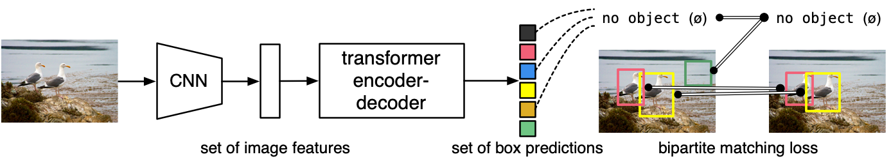
Libraries – Object Detection
facebook/detr-resnet-50
Notes:
ARIA

Slide 38
Libraries – Object Detection
facebook/detr-resnet-50
Notes:
ARIA

Slide 39
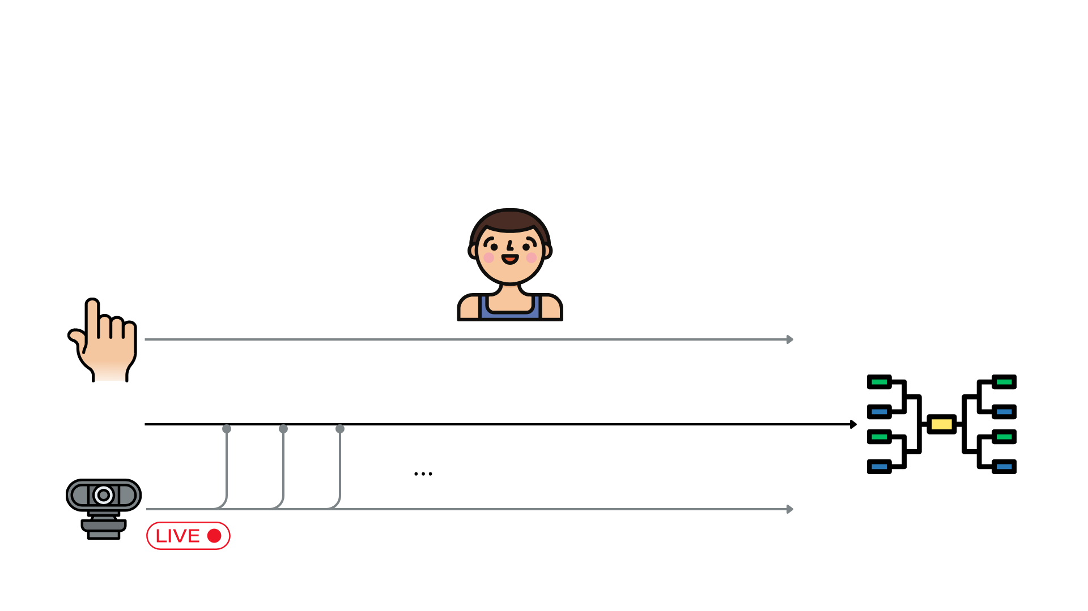
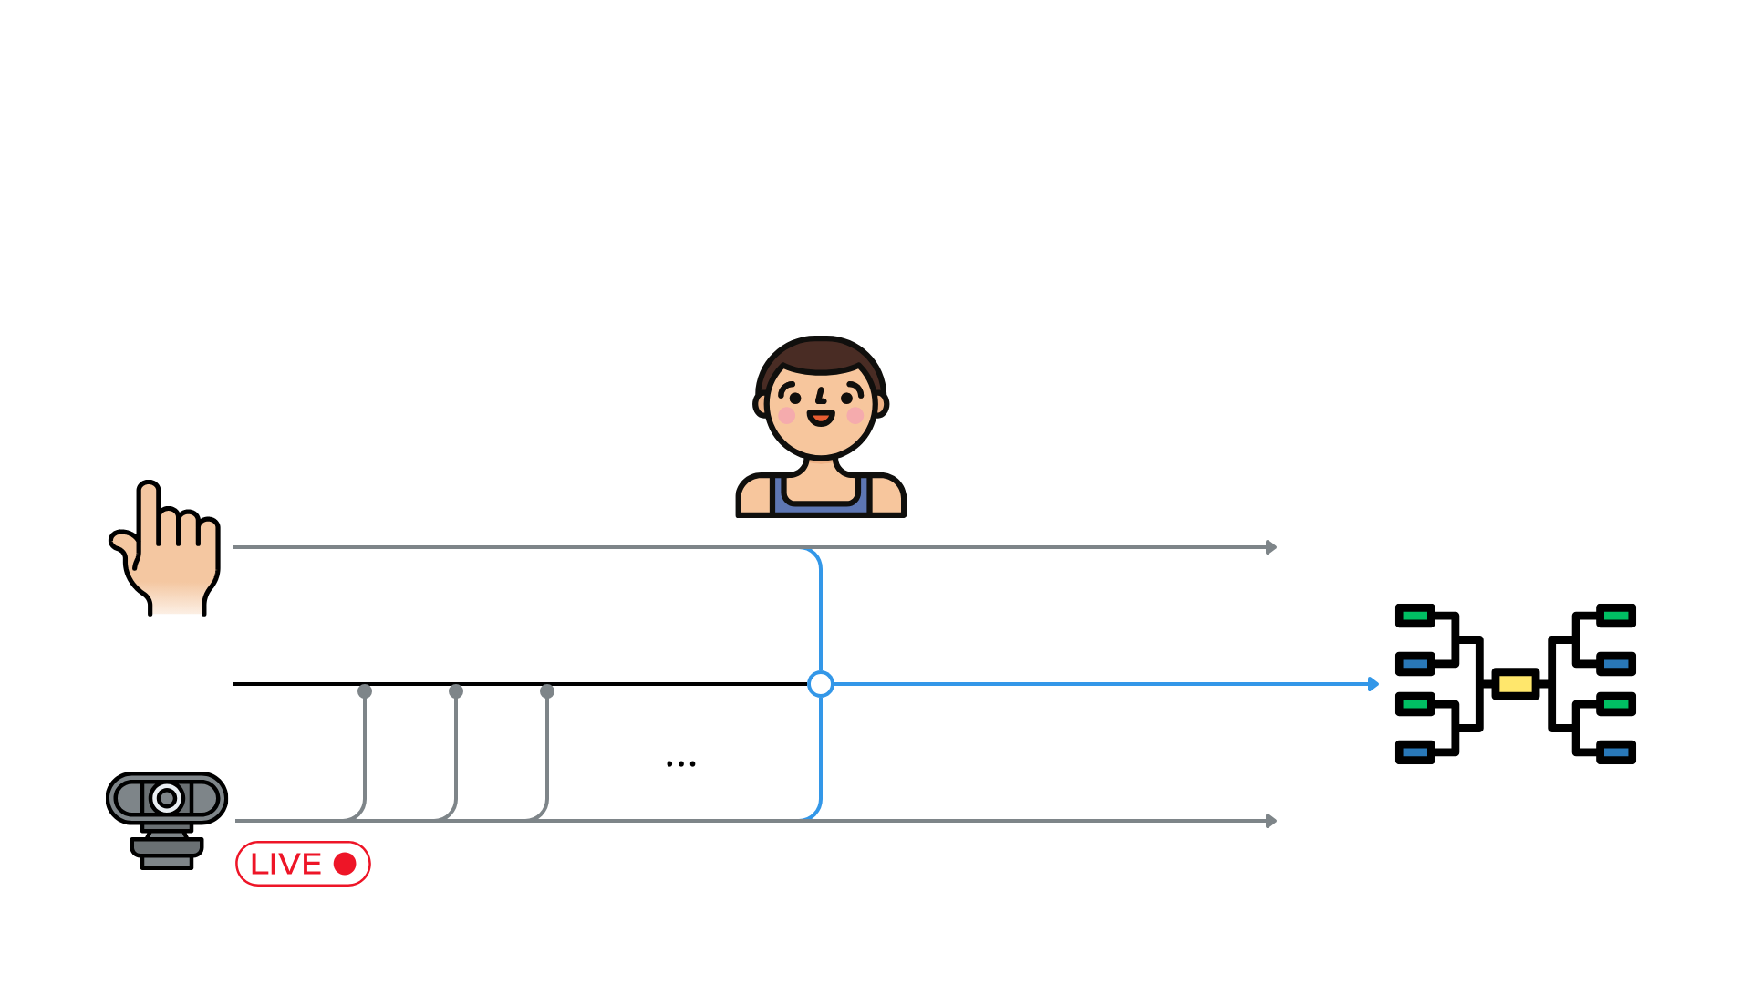
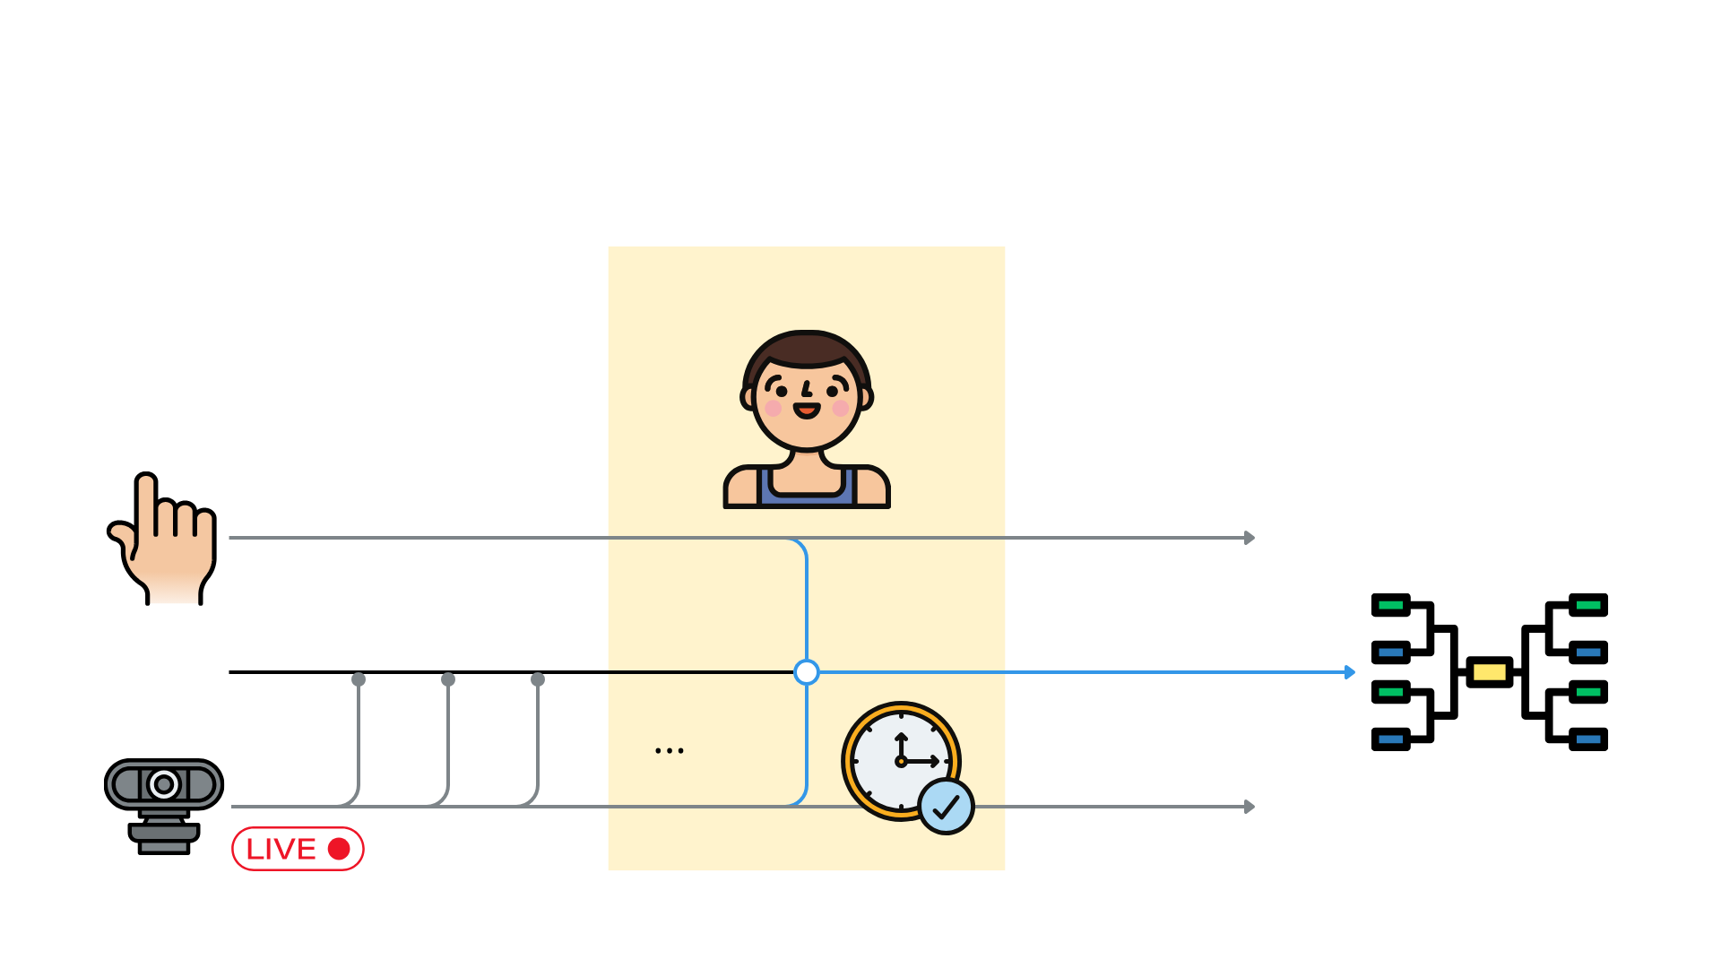

CARE Model
Complimentary

Slide 40
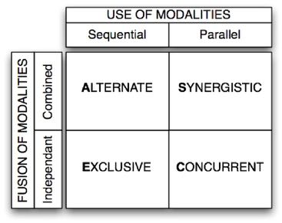
CASE Model
Synergistic
Notes:
CASE = Synergistic :
A task, in parallel, using several modalities

Slide 41
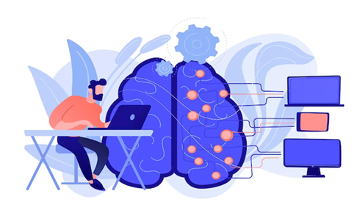
Limitations
Models Limitations:
Gesture and speech recognition models have inherent limitations
Object Recognition Errors:
Mistakes due to lighting or camera angles
Example: Object A misinterpreted as Object B

Slide 42

Future Works
Mobile Version:
Objective: Improve accessibility
Tasks: Optimize UI for small screens
Large Language Model (LLM) Integration:
Benefit: Complex, natural interactions
Example: Ask about object uses
Memory and Object Recognition:
Feature: Save and recognize personal items
Method: Fine-tune detection with user-provided images
Benefit: Locate items like keys and wallet

Slide 43
Limitations
Speech Recognition Challenges:
Not meant for real time retranscription
Issue: Transcription during no speech
Solution: Fine-tuned thresholds and chunk sizes, advanced filters
Color Recognition Issues:
Background sensitivity
Averaging within bounding boxes leading to inaccuracies
Example: Pink donut with green background leading to wrong color output

Slide 44

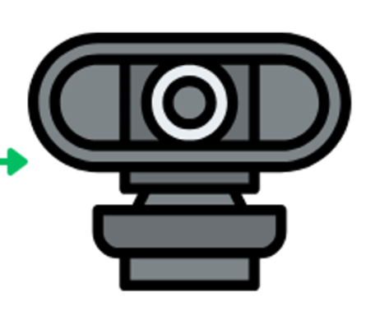

Modalities Fusion
Thread 1

Slide 45

Modalities Fusion
Thread 1
Video capture each frame (OpenCV)

Slide 46
Modalities Fusion
Video capture each frame (OpenCV)
Detect gesture on each frame (MediaPipe)
Thread 1

Slide 47


Modalities Fusion
Thread 2
User speaks

Slide 48

Modalities Fusion
Thread 2
User speaks
Trigger sentence recognised (Whisper)

Slide 49
Modalities Fusion
Thread 2
User speaks
Trigger sentence recognised (Whisper)

Slide 50
Modalities Fusion
Thread 2
User speaks
Trigger sentence recognised (Whisper)

Slide 51

Modalities Fusion
Index coordinates
Thread 1
Video capture each frame (OpenCV)
Detect gesture on each frame (MediaPipe)
Trigger object/color detection
"object", "color"
Thread 2
User speaks
Trigger sentence recognised (Whisper)

Slide 52
Modalities Fusion
Index coordinates
Thread 1
Video capture each frame (OpenCV)
Detect gesture on each frame (MediaPipe)
Trigger object/color detection
"object", "color"
Thread 2
User speaks
Trigger sentence recognised (Whisper)

Slide 53
Modalities Fusion
Index coordinates
Thread 1
Video capture each frame (OpenCV)
Detect gesture on each frame (MediaPipe)
Triggers object/color detection
"object", "color"
Thread 2
User speaks
Trigger sentence recognised (Whisper)

